Slide 1





Brac: Brand presence - Exposure Recognition
2025/08/05

Slide 2



Agenda
01
The Sponsorship Gap
02
AI Analytics Engine
03
Business Impact
04
Proof in Action
05
Next Steps

Slide 3


01
The Sponsorship Gap

Slide 4
Millions Spent,
Impact Unknown
Bundesliga clubs collect 2–70 M€ yearly from shirt deals, yet sponsors receive no reliable proof of brand visibility. This opacity blocks finance teams from linking payments to measurable brand outcomes.
2-70M€
0.1-3M€
21-25%
Shirt Sponsorships
LED Board Deals
of Club Revenue

Slide 5

Manual Tracking Fails Brands
Current reports rely on human spotters, producing inconsistent, subjective data. Without objective metrics, marketers cannot verify if multi-million fees deliver the promised 5–15% sales uplift .
Subjective & Inconsistent
Human estimates vary wildly, failing to provide a reliable baseline for valuation.
No ROI Link
Cannot connect visibility data to financial outcomes or promised sales uplifts.

Slide 6
02
Demo

Slide 7
Computer Vision for Every Frame
Our AI, trained on 71 German brands, ingests video to detect logos, record size and clarity, and tag key events, turning raw footage into structured, financial-grade data.
→
→
1. Ingest Video
2. AI Analysis
3. Structured Data
Live or recorded match footage.
Detects logos, clarity, and context.
Ready for financial interpretation.

Slide 8
03
Business Impact

Slide 9
A Tool for Every Stakeholder
The same dataset serves strategy, finance, and operations, creating a single source of truth for sponsorship performance across the entire ecosystem.
Rights-Holders
Brands
Agencies
Justify premium packages and quantify inventory with verified visibility data.
Calculate sales uplift potential and perform competitor benchmarking with precision.
Automate post-campaign reports and deliver audit-grade insights to clients.

Slide 10
04
Proof in Action

Slide 11
Proof in Action: A Real Match Snapshot
In a 2.8-minute clip, our system analyzed 4,773 frames and detected 16 brands. The data instantly separates high-impact partners from background noise.
#1 Allianz
#2 Audi
#3 Barmenia
68.9s
58.1s
24.4s
Total Visibility
Total Visibility
Total Visibility

Slide 12
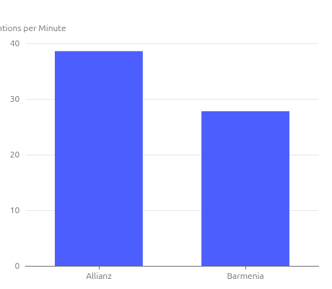
Benchmark Within Your Niche
Despite similar shirt placements, performance varies significantly. This granular data equips finance teams to argue for proportional fees or demand make-good inventory.
Allianz
38.6 mentions/min, 0.64s avg. exposure
Barmenia Gothaer
27.8 mentions/min, 0.32s avg. exposure

Slide 13
Smarter Partnerships Start Here
By revealing exactly how long, how clearly, and how prominently every logo appears, we convert video into actionable financial insight. This is the future of data-driven sponsorship.
→
→
Video Footage
AI Analysis
Financial Insight
Embrace AI-driven transparency and out-perform the competition.

Slide 14






THANK YOU
2025/0/05

